Slide 1
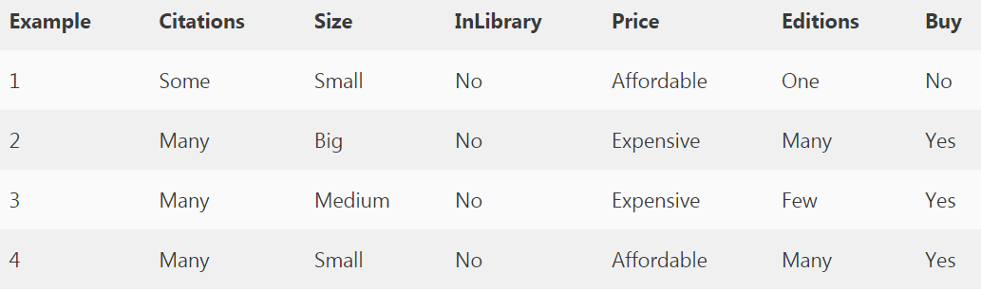
S0: (0, 0, 0, 0, 0) Most Specific Boundary
G0: (?, ?, ?, ?, ?) Most Generic Boundary

Slide 2
The first example is negative, the hypothesis at the specific boundary is consistent, hence we retain it, and the hypothesis at the generic boundary is inconsistent hence we write all consistent hypotheses by removing one “?” at a time.
{ <Some,Small,No,Affordable,One> No}
S1: (0, 0, 0, 0, 0)
G1: (Many,?,?,?, ?) (?, Big,?,?,?) (?,Medium,?,?,?) (?,?,?,Exp,?) (?,?,?,?,Few)

Slide 3
S2: (Many, Big, No, Exp, Many)
G2: (Many,?,?,?, ?) (?, Big,?,?,?) (?,?,?,Exp,?) (?,?,?,?,Many)
The third example is positive, the hypothesis at the specific boundary is inconsistent, hence we extend the specific boundary, and the consistent hypothesis at the generic boundary is retained and inconsistent hypotheses are removed from the generic boundary.
S3: (Many, ?, No, Exp, ?)
G3: (Many,?,?,?,?) (?,?,?,exp,?)
S4: (Many, ?, No, ?, ?)
G4: (Many,?,?,?,?)
(Many, ?, No, ?, ?) (Many, ?, ?, ?, ?)

Slide 4
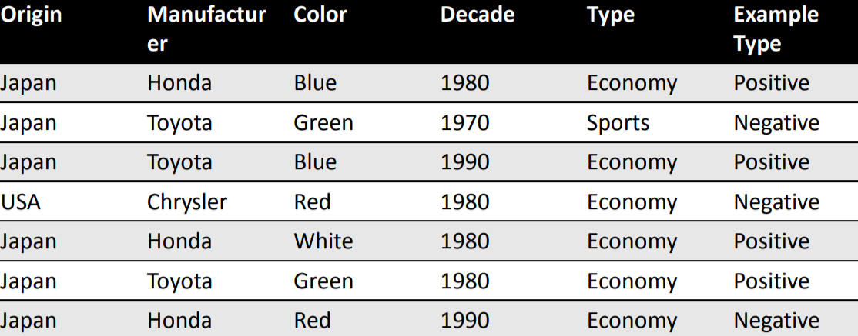
G = { (?, ?, ?, ?, ?) }
S = { (Japan, Honda, Blue, 1980, Economy) }
G = { (?, Honda, ?, ?, ?), (?, ?, Blue, ?, ?), (?, ?, ?, 1980, ?), (?, ?, ?, ?, Economy) }
S = { (Japan, Honda, Blue, 1980, Economy) }
G = { (?, ?, Blue, ?, ?), (?, ?, ?, ?, Economy) } S = { (Japan, ?, Blue, ?, Economy) }

Slide 5
Positive Example 1
(Japan, Honda, Blue, 1980, Economy)
• Initialize G to a singleton set that includes everything.
G = { (?, ?, ?, ?, ?) }
• Initialize S to a singleton set that includes the first positive example.
S = { (Japan, Honda, Blue, 1980, Economy) }

Slide 6
Negative Example 2
(Japan, Toyota, Green, 1970, Sports)
• Specialize G to exclude the negative example.
G = { (?, Honda, ?, ?, ?), (?, ?, Blue, ?, ?), (?, ?, ?, 1980, ?), (?, ?, ?, ?, Economy) }
S = { (Japan, Honda, Blue, 1980, Economy) }

Slide 7
Positive Example 3
(Japan, Toyota, Blue, 1990, Economy)
• Prune G to exclude descriptions inconsistent with the positive example.
G = { (?, ?, Blue, ?, ?), (?, ?, ?, ?, Economy) }
Generalize S to include the positive example.
S = { (Japan, ?, Blue, ?, Economy) }

Slide 8
Negative Example
(USA, Chrysler, Red, 1980, Economy)
• Specialize G to exclude the negative example (but stay consistent with S)
G = { (?, ?, Blue, ?, ?), (Japan, ?, ?, ?, Economy) } S = { (Japan, ?, Blue, ?, Economy) }

Slide 9
Positive Example
(Japan, Honda, White, 1980, Economy)
• Prune G to exclude descriptions inconsistent with positive example.
G = { (Japan, ?, ?, ?, Economy) }
• Generalize S to include positive example.
S = { (Japan, ?, ?, ?, Economy) }

Slide 10
Positive Example: (Japan, Toyota, Green, 1980, Economy)
• New example is consistent with version-space, so no change is made.
G = { (Japan, ?, ?, ?, Economy) }
S = { (Japan, ?, ?, ?, Economy) }

Slide 11
Negative Example:
(Japan, Honda, Red, 1990, Economy)
• Example is inconsistent with the version-space. G cannot be specialized. S cannot be generalized.
• The version space collapses.
• Conclusion: No conjunctive hypothesis is consistent with the data set.

